Slide 1


Bellabeat Case Study
Google Data Analytics Capstone Project
- - -Thought process included- - -
Presented by David (Vigne) Ruiz Diaz

Slide 2
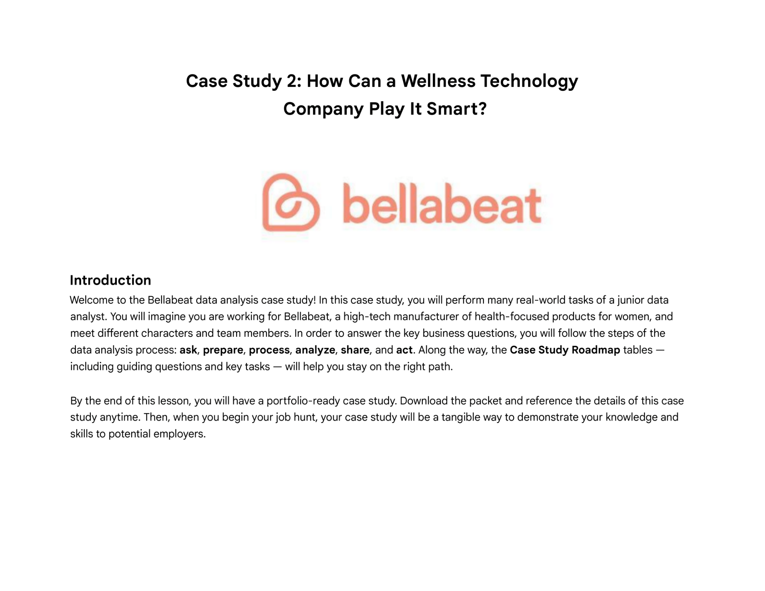
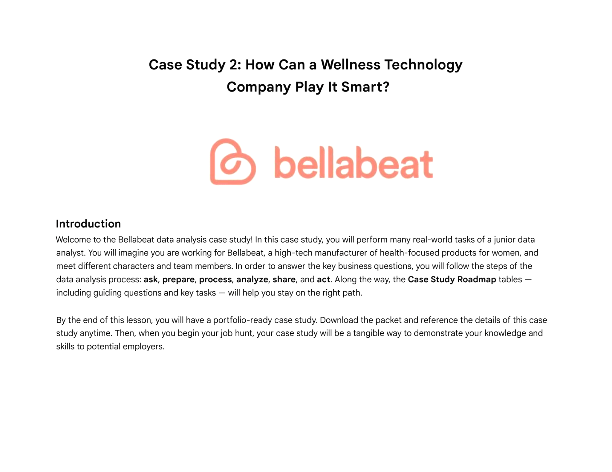
Documentation Overview
Health-focused smart product company
Data is from non-Bellabeat smart devices
6 deliverables
Ask
Prepare
Process
Analyze
Share
Act

Slide 3

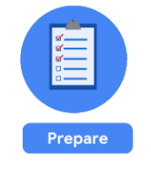
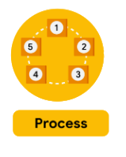
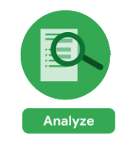

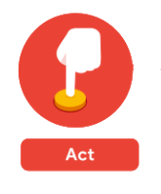
Deliverables
6 deliverables
Ask
A clear statement of the business task
Prepare
A description of all data sources used
Process
Documentation of any cleaning or manipulation of data
Analyze
A summary of your analysis
Share
Supporting visualizations and key findings
Act
Your top high-level insights based on your analysis

Slide 4
Ask

Slide 5
First approach
Thought Process
Prior to the first glance of the dataset I had a few questions that could lead my path:
What is the relation between stress and hydration?
Are there any pattern between sleeping hours and stress levels?
What patterns could bring the highest value to the marketing strategy?
Is the data sufficient to provide high value insight? What are some of their properties?
Most of this questions would end up being insufficient enough. Later in the presentation we will realize the proper scope to lead more accurate insight.

Slide 6
Prepare

Slide 7
First glance of data
Thought Process
Data stored in Kaggle Repository.
Data is divided into 2 folders and 29 csv files.
dailyActivies_merged seems to have data from the other files, further check necessary
Data provided did not include stress/hydration values, ASK phase has to be re-addressed
Not ROCCC data
Most of this questions would end up being insufficient enough. Later in the presentation we will realize the proper scope to lead more accurate insight.

Slide 8
Ask
Business task
What are the relations that we can find in users who use smart devices?
Can we use this data to make a Marketing oriented decision?
Can we leverage from this data to improve our product?

Slide 9
Prepare
Data is stored in KAGGLE. It has 29 CSV files dividing information by Hourly and Daily data.
Dataset was generated by respondents to a distributed survey via Amazon Mechanical Turk between 03.12.2016-05.12.2016.

Slide 10
Prepare
Data does not ROCCC
Reliable: Data lacks reliability as it is derived from a sample size of only 33 users, which is too small.
Original: Data is not original as it was initially collected through Amazon Mechanical Turk.
Comprehensive: While the data is well distributed among various files, additional information such as age or gender would enhance its comprehensiveness.
Current: The data was collected in 2016, rendering it 8 years old and therefore not current.
Cited: Although the repository asserts that the data was provided by Amazon Mechanical Turk, there is no evidence to support this claim despite their affirmation.

Slide 11
Process

Slide 12
The right tool
Thought Process
Tool choosed is MS Excel
Check if MS Excel may present difficulties while dealing with the dataset
Excel does provide with useful features that can make data cleaning easier and more effective. Taking in count that dataset is long distributed, we can macro our validation checks in case it were necessary.
We have access to Power Query
Data cleaning will consist of:
Check the amount of smart device users in the dataset
Check for duplicates
Check the integrity of data and correlation in Daily Activity against each gathered data

Slide 13


Cleaning Data
Cleaning Process
We make a copy of the documents we are going to clean, in case we have to go back to original source in the future.
We leverage of the COUNTA & UNIQUE function to count the amount of ID presented in Daily Activity
We use CONCAT function to make an unique value with ID and Date, to check if there’s duplicate data (we will use Conditional Formatting to check for duplicates in the array)

Slide 14
Cleaning Data
Cleaning Process
We use Powerquery correct the format of Number values and Date types.
Once determined that there is no duplicate information we proceed to check if the data in daily activity is the same as those presented in the Daily Steps, Daily Calories and Daily Intensities.
We will use Xlookup to check for the ID+Date from Daily Activities and check if the result amount of calories equals those with the same ID+Date from the Daily Calories

Slide 15

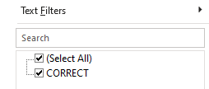
Cleaning Data
Cleaning Process
Then we use an IF function to compare the calories with Correct and Incorrect
Lastly we use a Filter in the column we are checking to make sure there are no INCORRECT values

Slide 16
Process
Data presented no duplicates
Cleaning was made formatting mainly the Date type which presented inconsistency
While cleaning the data key information was found:
33 ID are uniques in the dataset, which means this data only provides information from 33 users.

Slide 17
Analyze

Slide 18
Connections
Thought Process
Consider the key aspects of the dataset and leverage Tableau to find connections. The main focus will be:
Activity habits
Sleeping records
Calories
Daily steps

Slide 19
Analyze
Determine the distribution of activity habits (Total and daily average)
Check the amount of Sleeping records
Determine the daily distribution of time in bed and sleeping time
Search for patterns between calories and relevant activity habit
Discover the amount of users who accomplish the recommended amount of daily steps

Slide 20
Share

Slide 21
Distribution of activity habits

Slide 22
Among the 33 participants there’s a clear tendency to Sedentary Habits (inactive minutes)
Given this dataset, we cannot conclusively determine if this tendency is influenced by the context.
We lack information regarding gender, age, job position, health conditions, or any other data that could provide context to explain why individuals may be less active.

Slide 23
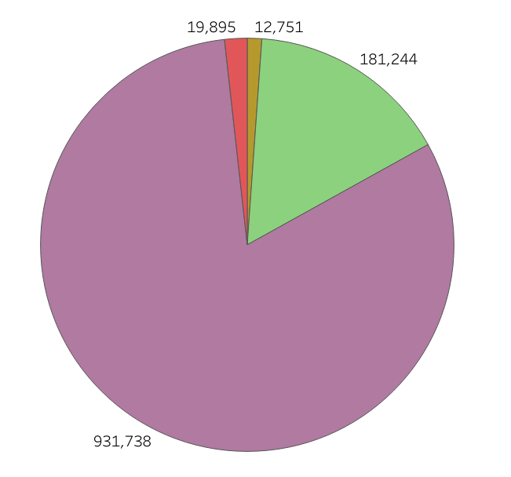
Summarize activity levels
[81%] Sedentary minutes
[16%] Lightly Active minutes
[01%] Fairly Active minutes
[02%] Very Active minutes
Considerable prevalence of Sedentary Habits

Slide 24
Sleeping Records

Slide 25
410 Sleeping records out of 1023 cases.
This is a 40% of the total possible cases.
24 users provided at least one sleeping record
15 users provided at least half the records of the total cases
Only three users provided sleeping records for the total amount of days.

Slide 26
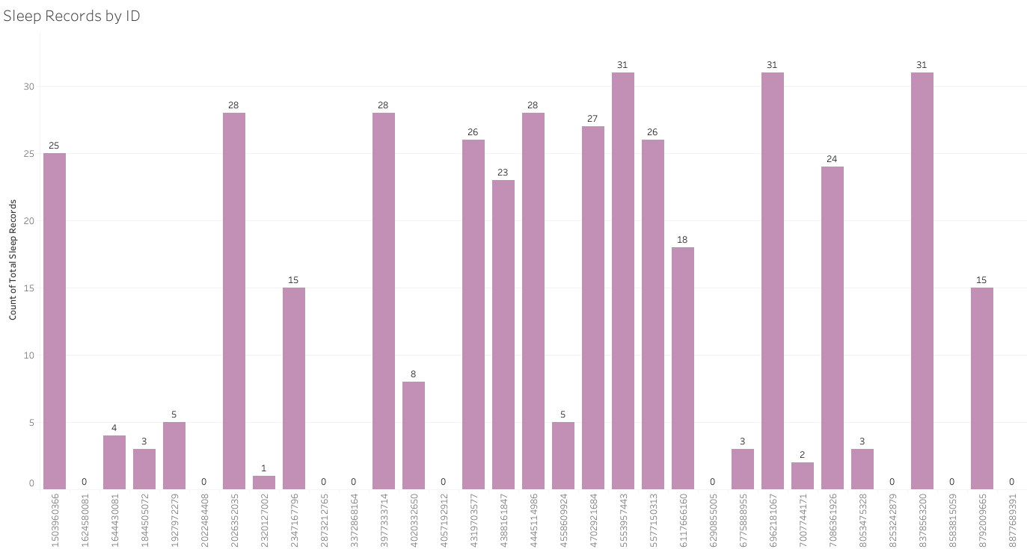
Only 40% was recorded

Slide 27
All users takes around an hour to sleep on average
The larger case was slightly above an hour to sleep from the moment the user went to bed

Slide 28
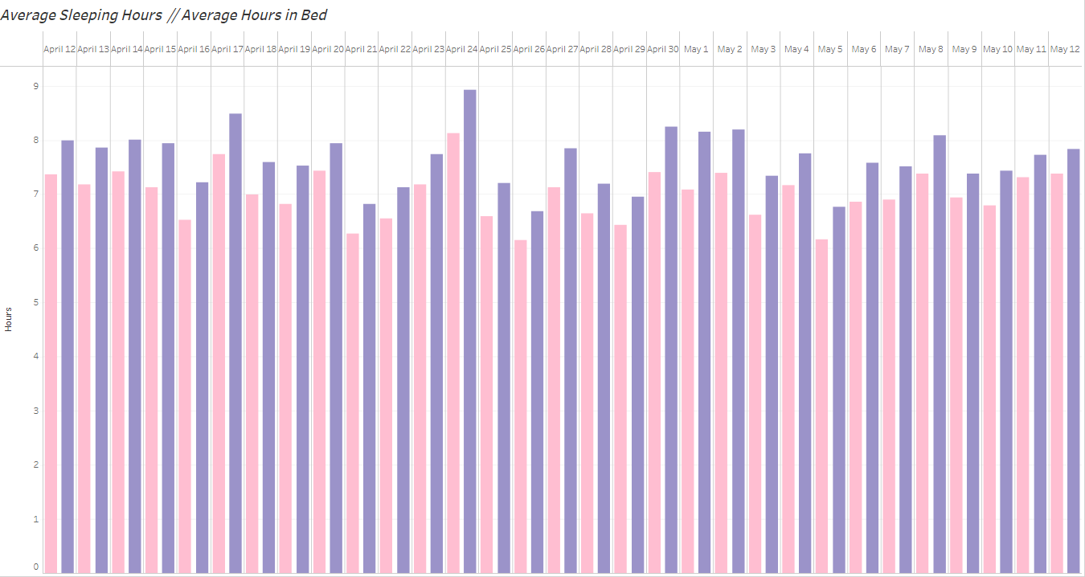
Hours Asleep
Hours in Bed

Slide 29
The average of calories consumed is not related to the activity habit
The are not relations between the choice of activity habits
We consider the two most prevalent types of activity registered in minutes

Slide 30
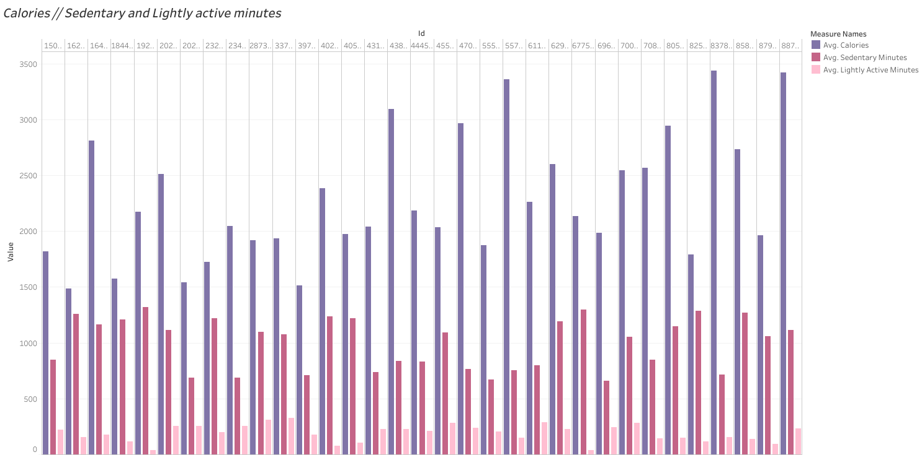
Average Calories
Avg. Sedentary minutes
Avg. Lightly Active minutes
No relation between Calories consumed and activity habit

Slide 31
Only 7 users out of 33 accomplish the recommended daily steps
There are 12 users who perform the recommended steps vaguely and not constantly

Slide 32
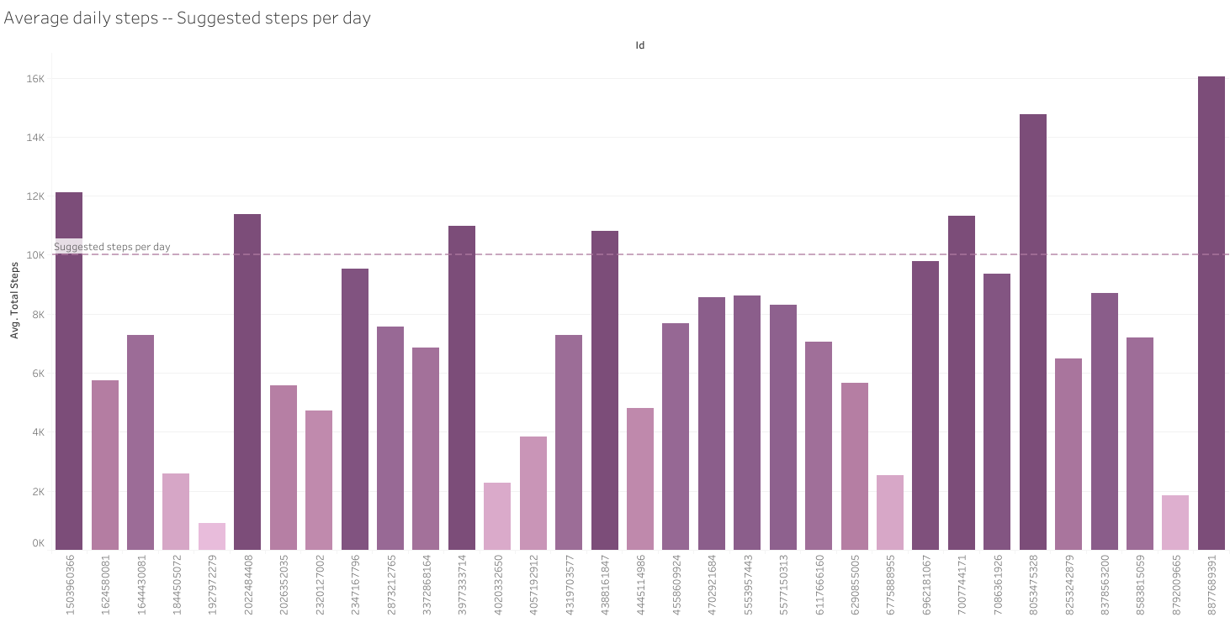
ONLY 21% OF USERS ACCOMPLISH RECOMMENDED STEPS PER DAY

Slide 33
Act

Slide 34
What are the relations that we can find in users who use smart devices?
We identified a clear tendency towards sedentary habits.
We observed gaps between time spent in bed and effective sleep.
We recognize that there is no relationship between calories consumed and activity habits.
We uncovered a low percentage of users who complete the recommended daily steps.

Slide 35
Can we use this data to make a Marketing oriented decision?
We need to be cautious when using this data for our marketing strategy since it is not current, and the sample size is too small.
However, the insights into sleeping patterns could offer us an opportunity to further analyze why users typically take around an hour to fall asleep and how this impacts their daily stress levels in depth.
We could collaborate with a non-governmental organization (NGO) to launch a campaign promoting daily walks to help individuals achieve the recommended daily steps. Focusing on this initiative could position us as a leading brand for promoting healthy habits

Slide 36
Can we leverage from this data to improve our product?
We can leverage from this data, but further gathering will be required.
We can focus the data gathering on why users did not provide records of their sleep:
Device issues (hardware or software related)
Discomfort sleeping with the device
Battery issues
Once identified, we can direct our engineers to develop solutions for these issues.

Slide 37
Conclusion

Slide 38
The data was insufficient for certain analyses as it did not include gender or age information of the users. The small sample size underscores the importance of caution while making impulsive decisions based on this analysis.
Nevertheless, the data provided valuable insights into how we should scope our next data gathering efforts and adjust our marketing strategy accordingly

Slide 39
Questions?

Slide 40
Thanks

